Slide 1
Temperature-dependent competition in container breeding mosquito species
Michelle Evans

Slide 2
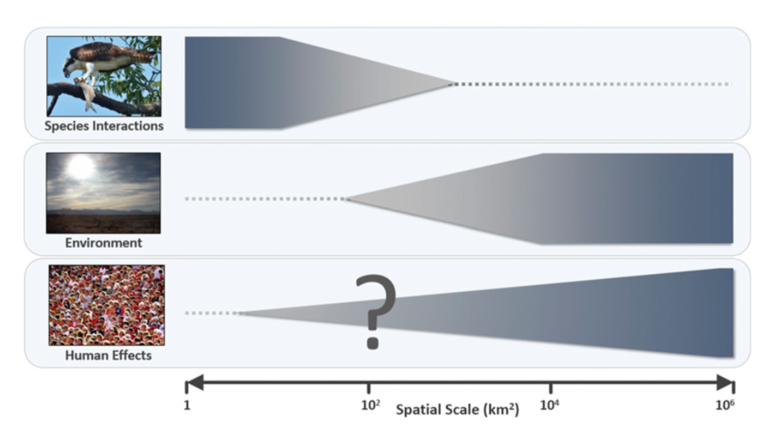
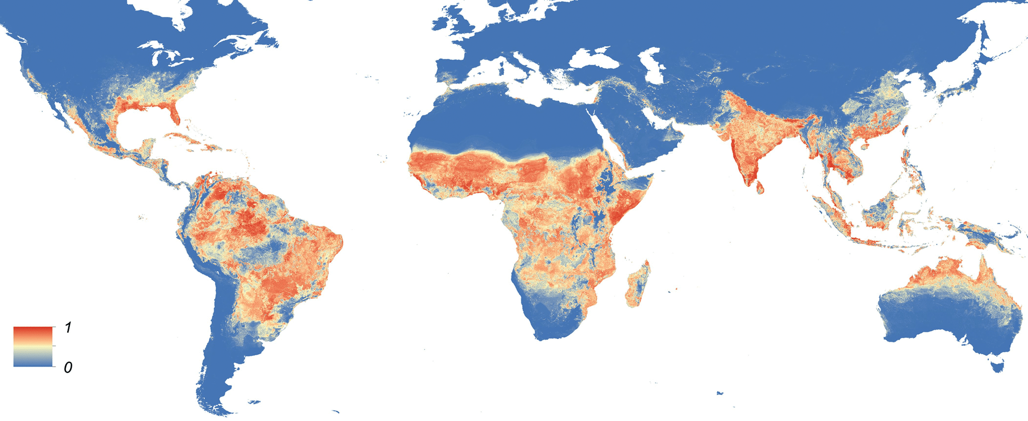
What processes drive spatial patterns in disease?
Relative importance of abiotic vs. biotic factors in ecological processes
What about interactions between abiotic and biotic effects?
Predictions of mosquito-borne disease are based on abiotic conditions, often ignoring biotic processes such as density dependence
Cohen et al. 2016 PNAS, Kraemer et al. 2015 eLife

Slide 3
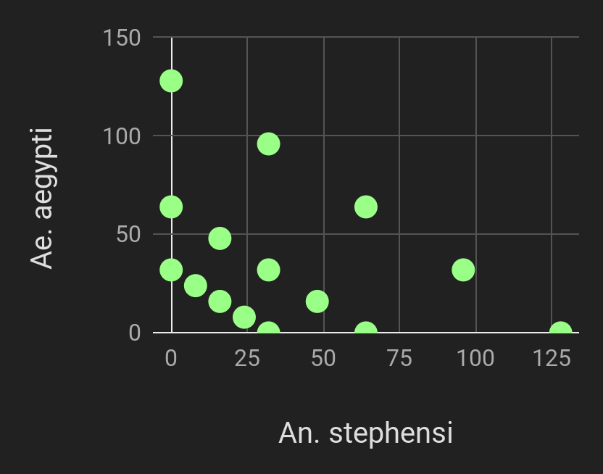
Two-species competition across a temperature gradient
Aedes aegypti vs. Anopheles stephensi
Across five fluctuating temperatures
16C
20C
24C
28C
32C
Response surface design ~ 15 density treatments
Female adults were bloodfed & monitored for eggs and death
Data collected:
Survival
Mosquito development rates
Fecundity rates
Adult longevity
Population
growth rates

Slide 4
Applying mixed models to response variables
Survival
Ae. aegypti:
binomial GZLM
An. stephensi:
binomial GZLM
Fecundity
Ae. aegypti:
Zero-inflated negative binomial GZLM
An. stephensi:
Negative binomial hurdle model
Growth Rates
Ae. aegypti:
Linear mixed model
An. stephensi:
Linear mixed-effects hurdle model

Slide 5
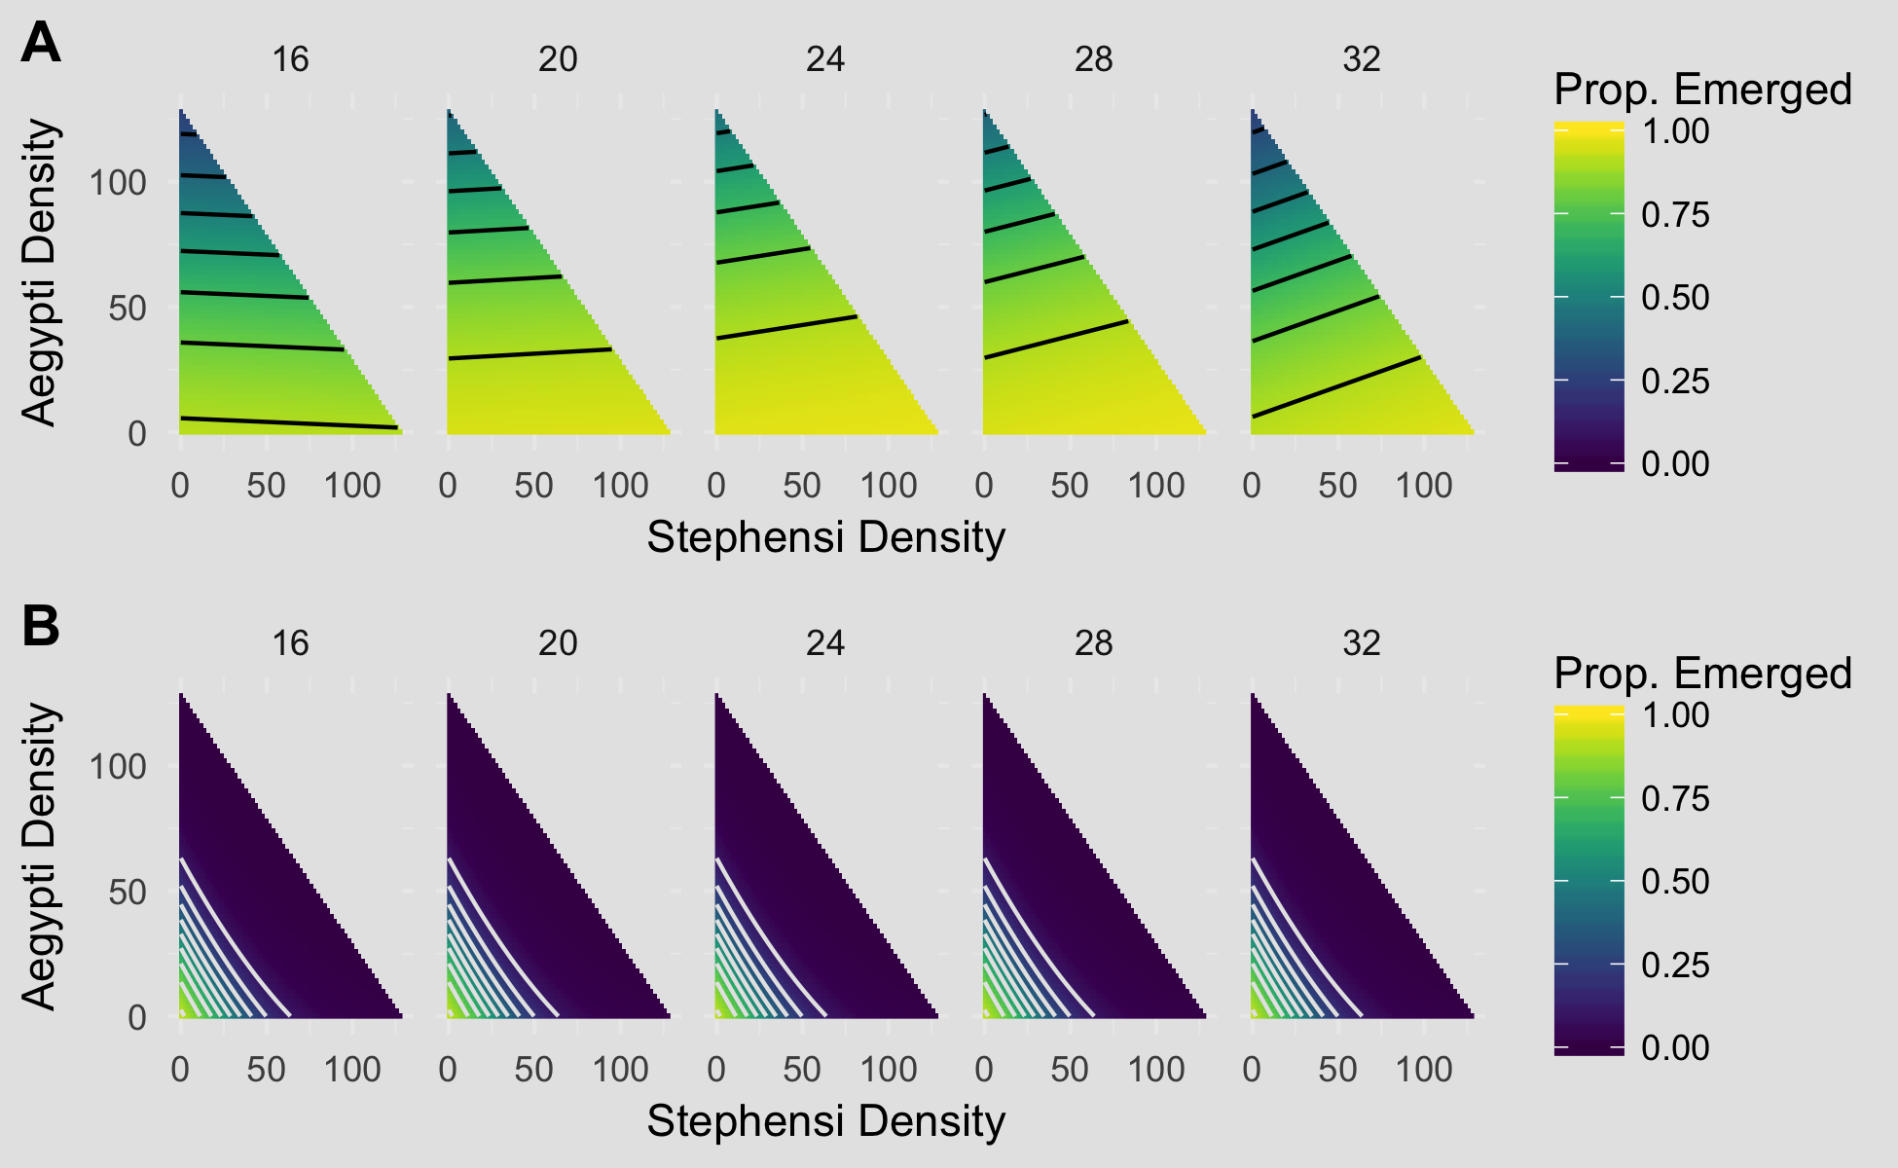
SURVIVAL TO ADULTHOOD
Ae. aegypti
An. stephensi

Slide 6
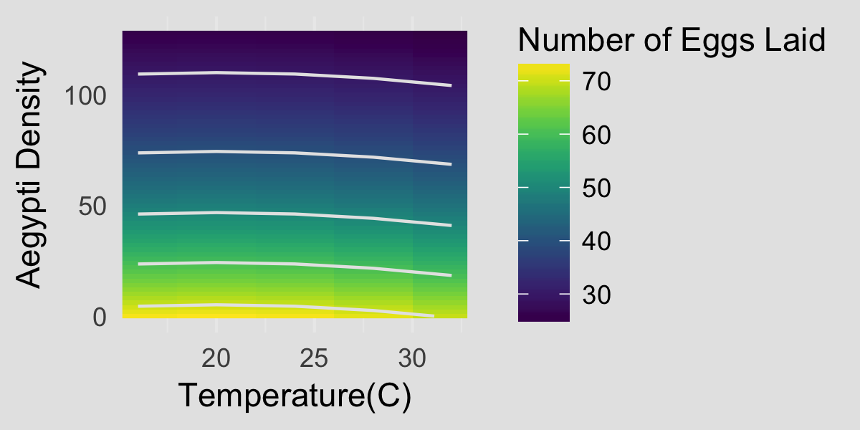
FECUNDITY
Ae. aegypti
No effect of experimental treatment,
𝞵 = 16.94 (𝞵_{zeros removed} =67.04)
An. stephensi

Slide 7
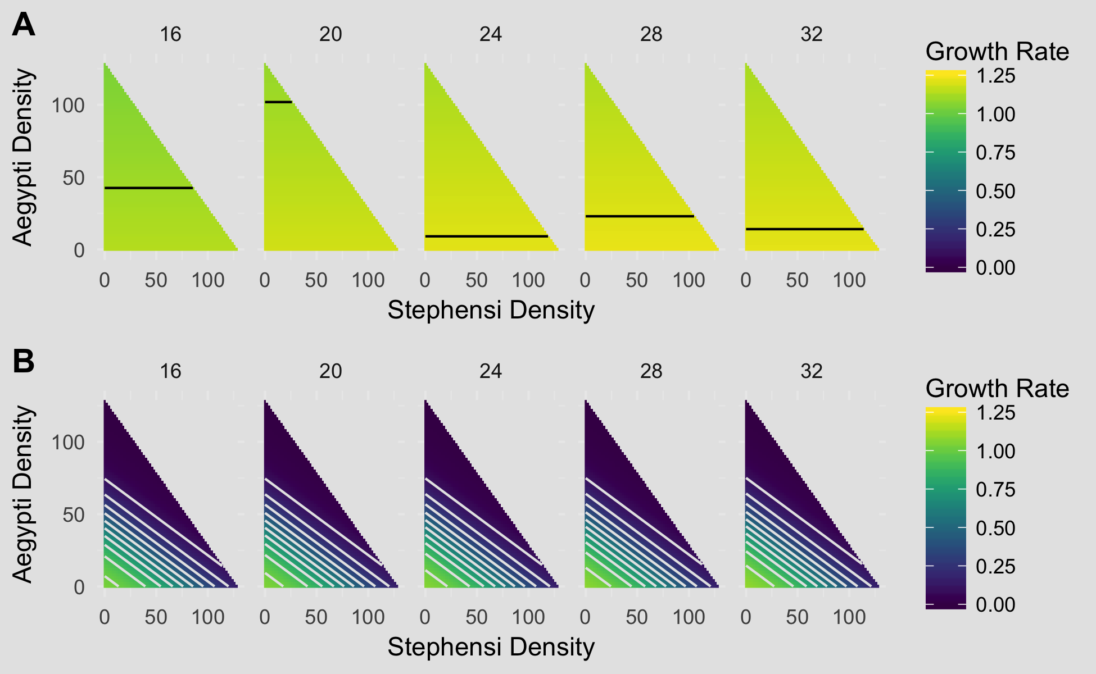
PER CAPITA GROWTH RATE
Ae. aegypti
An. stephensi

Slide 8
Conclusions
Ae. aegypti outcompetes An. stephensi at all temperature regimes
An. stephensi is more sensitive to interspecific density than intraspecific density
All Ae. aegypti demographic parameters are sensitive to temperature, whereas An. stephensi is not
Likely that regional coexistence is driven by habitat partitioning
Next steps: Incorporate experimental parameters into Lotka-Volterra models

Slide 9

Questions?

Slide 10
Survival
 | Temperature | Intraspecific density | Interspecific density | Interactions
Ae. aegypti response | Unimodal, T_{opt} ~ 26C | Negative (-1.99) | Negative (-0.604) | Interspecific x Temperature
An. stephensi response | Unimodal, T_{opt} ~ 26C | Negative (-5.161) | Negative (-6.287)

